Slide 2
learn concepts of recommendation systems.
learn techniques in recommendation system.

Slide 3
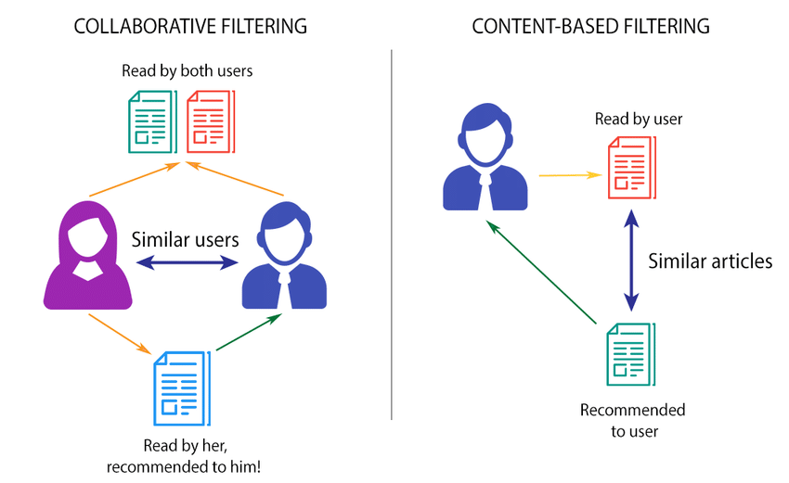
Collaborative filtering vs Content-based filtering

